Slide 1
Resources for Teachers on the COVID-19 Vaccines
Name of School or School District

Slide 2
About the We Can Do This Campaign

Slide 3
We Can Do This Campaign
The U.S. Department of Health and Human Services (HHS) COVID-19 Public Education Campaign is a national initiative to increase public confidence in and uptake of COVID-19 vaccines while reinforcing basic prevention measures such as mask wearing and social distancing.
Through a nationwide network of trusted messengers like you and consistent, fact-based public health messaging, the Campaign helps people make informed decisions about their health and COVID-19, including steps to protect themselves and their communities.

Slide 4
Your Role as a Teacher
As an educator, you serve as a trusted messenger who parents may come to with their questions or concerns about COVID-19 vaccines and their children.
This presentation gives you the resources and science-based information you need to have conversations, answer frequently asked questions, and dispel common myths about the COVID-19 vaccines.
This presentation also familiarizes you with our school’s rules and guidelines that pertain to COVID-19 safety and vaccines.
Use your influence and share factual COVID-19 prevention tips, vaccine messaging, and encouragement.

Slide 5
Tips for Having Conversations to Increase Vaccine Confidence
Listen to people’s questions. Listen without judgment and identify the reasons for their concerns. Acknowledge how they’re feeling.
Ask open-ended questions. Understand what the parent is worried about, where they get their vaccination information, and what they’ve done to get answers to their questions.
Ask permission to share information. Ask if you can provide them with some information from trusted sources—including CDC.gov; local health department websites; the school nurse; or their local doctor or pharmacist.
What is Vaccine Confidence?
Vaccine confidence is the trust that people have in:
Recommended vaccines
Providers who administer vaccines; and
Processes and policies that lead to vaccine development, licensure or authorization, manufacturing, and recommendations for use.

Slide 6
Guidance and Talking Points

Slide 7
Who Can Get Vaccinated?
Everyone age 5 and older can now get a COVID-19 vaccine. There are three ways to find vaccines near you:
Go to vaccines.gov
Text your ZIP code to 438829
Call 1-800-232-0233

Slide 8
Kids, Teens, and COVID Vaccines
Although fewer children have been infected with COVID-19 compared to adults, children can:
  Be infected with the virus that causes COVID-19
  Get sick from COVID-19
  Spread COVID-19 to others
CDC recommends everyone 5 years and older should get a COVID-19 vaccination to help protect against COVID-19. Children 5 and older can get the Pfizer-BioNTech COVID-19 vaccine.
COVID-19 vaccines have been used under the most intensive safety monitoring in U.S. history, which includes studies in adolescents.

Slide 9
Heart Inflammation and COVID-19
There have been a small number of cases of inflammation of the heart—called myocarditis and pericarditis—happening in adolescents and young adults after mRNA COVID-19 vaccination (i.e., Pfizer-BioNTech, Moderna) in the United States.
These reports are rare, given the hundreds of millions of vaccine doses administered.
In addition, we know that myocarditis and pericarditis are much more common if you get COVID-19, and the risks to the heart from COVID-19 infection can be more severe.
The known and potential benefits of COVID-19 vaccination outweigh the known and potential risks of the virus, including the possible risk of myocarditis or pericarditis.
CDC continues to recommend COVID-19 vaccination for everyone 5 and older, given the risk of COVID-19 illness and related complications that could be severe, such as long-term health problems, hospitalization, and even death.

Slide 10
Common FAQs and Talking Points
Use these fact-based talking points in your messaging with fellow educators and parents.
Question | Talking Points
Are COVID vaccines safe for kids? | The COVID-19 vaccine was rigorously tested in thousands of children before authorization by the FDA. The vaccine was shown to be safe and effective during the clinical trials. Children had the same kinds of temporary side effects from vaccines as adults. Side effects during the clinical trials were usually mild and went away on their own in a few days. COVID-19 vaccines are being used under the most intensive safety monitoring in U.S. history..
Do kids really need a vaccine if they’re young and healthy? | Children can still get sick and get long-term complications from the virus. They can also spread it to others.
Will getting a COVID vaccine change my DNA? | COVID vaccines do not change or interact with your DNA in any way. The genetic material in the vaccines never enters the nucleus of the cell where our DNA is kept.
Will getting a COVID vaccine give me COVID? | None of the vaccines contain the live virus that causes COVID-19, so they cannot make you sick with COVID-19.
If I’ve already had COVID-19, do I need a vaccine? | Evidence shows that being vaccinated after having COVID-19 strengthens immunity to give you better protection.
Do COVID-19 vaccines affect fertility? | Currently, no evidence indicates that any vaccines, including COVID-19 vaccines, cause fertility problems in women or men.
Do COVID-19 vaccines cause long-term health effects? | Serious side effects that would cause a long-term health problem are extremely rare following COVID-19 vaccination. The risk of a serious illness from COVID-19 itself is much higher.

Slide 11
Talking Points (Continued)
Question | Talking Points
Will I or my child get myocarditis or pericarditis from receiving the Pfizer-BioNTech vaccine? | Reports of myocarditis or pericarditis (heart inflammation) following vaccination are extremely rare, given the hundreds of millions of vaccine doses that have been given. Most patients who received care responded well to treatment and rest and quickly felt better. It’s important to note that COVID-19 can also cause this kind of heart inflammation.
Can I get the COVID-19 vaccine while I’m on my period (or when my child is on their period)? | According to CDC and the American College of Obstetricians and Gynecologists, there’s no reason to put off getting vaccinated if someone is on their period. CDC and the FDA closely monitor safety data and have not seen any patterns of concern.
Do parents need to give consent before a vaccine is given to an eligible minor? | The federal government does not have specific requirements for medical consent for vaccination. States/jurisdictions have medical consent laws that address the circumstances under which a medical provider must seek consent prior to a medical procedure and the processes for obtaining that consent. These laws vary across jurisdictions. Providers may also be subject to policy requirements for consent within their own organizations.
Do the vaccines protect against the Delta variant? | Yes. The available COVID-19 vaccines are safe and highly effective against severe illness, hospitalization, and death due to COVID-19, including from Delta and other known variants.

Slide 12
NAME OF SCHOOL OR SCHOOL DISTRICT Guidelines

Slide 13
How is our school protecting our students?
Suggested Topics
Guidance on COVID-19 Vaccines
Guidance on Masks
[List the school’s recommendations for getting vaccinated against COVID-19.]
[List the school’s recommendations for mask-wearing to protect against COVID-19.]

Slide 14
How is our school protecting our students?
Suggested Topics
Guidance on COVID-19 Testing
Guidance on In-Person Learning
[List the school’s recommendations for getting tested for COVID-19.]
[List the safety protocols you’ve adopted at your school to keep students safe from the virus that causes COVID-19 while in school.]

Slide 15
Links to Helpful Resources

Slide 16
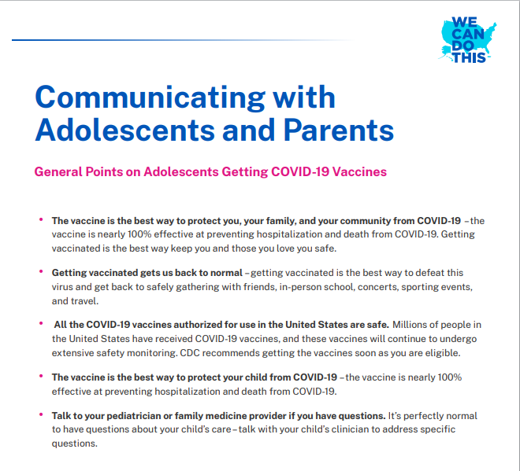
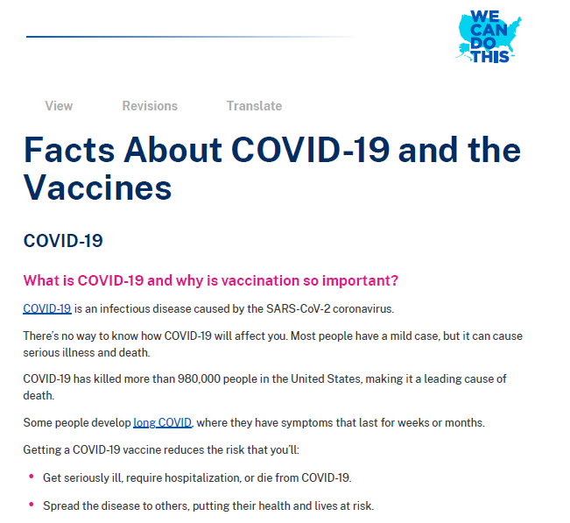
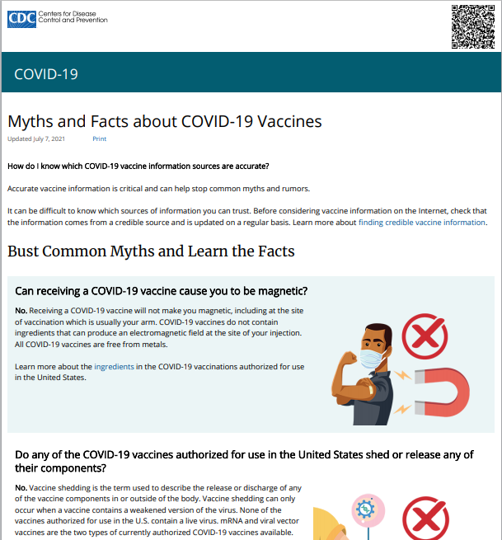
Additional Resources
Communicating with Adolescents and Parents
Facts About COVID-19 and the Vaccines
Myths and Facts About COVID-19

Slide 17
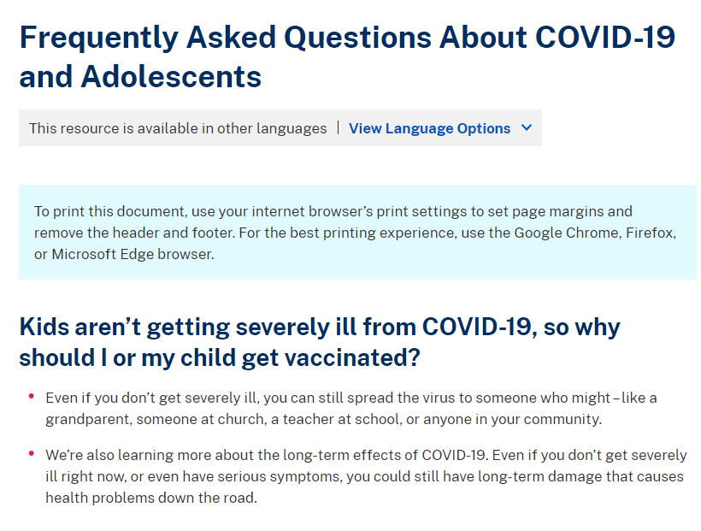
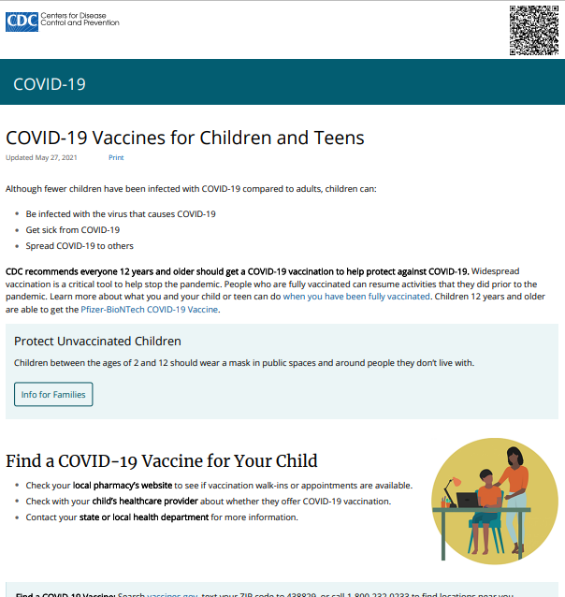
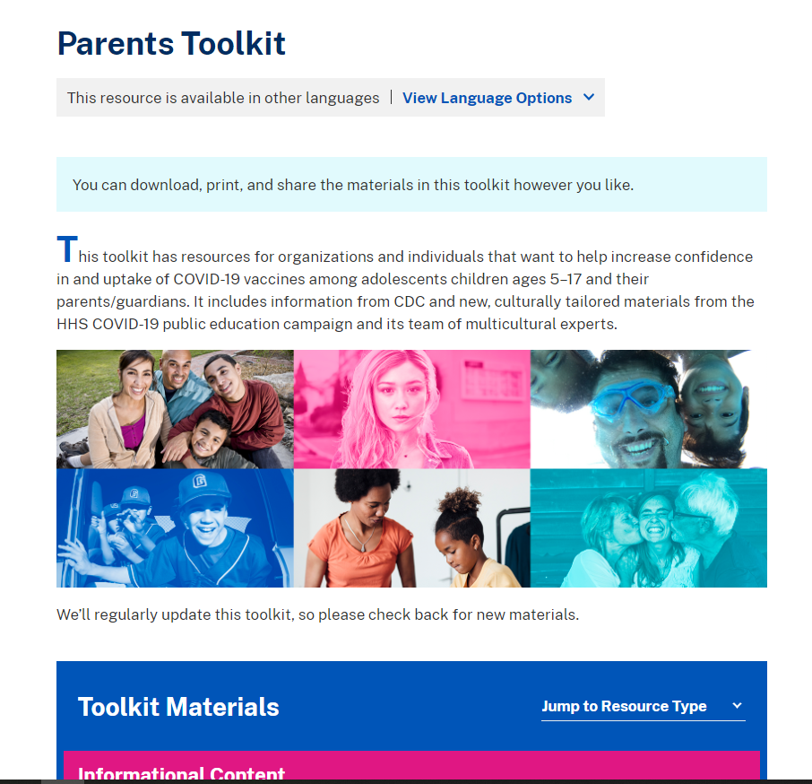
Additional Resources (Continued)
FAQs About COVID-19 and Adolescents
COVID-19 Vaccines for Children and Teens
Parents Toolkit

Slide 18
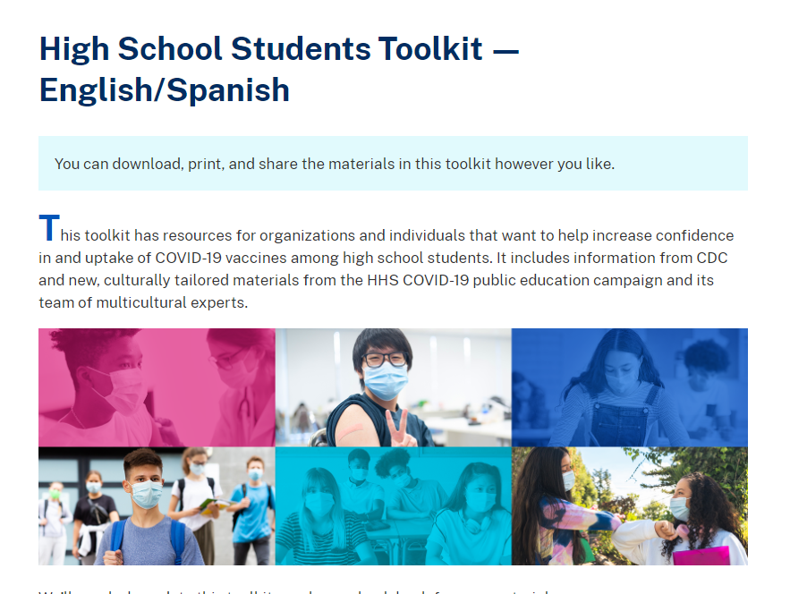
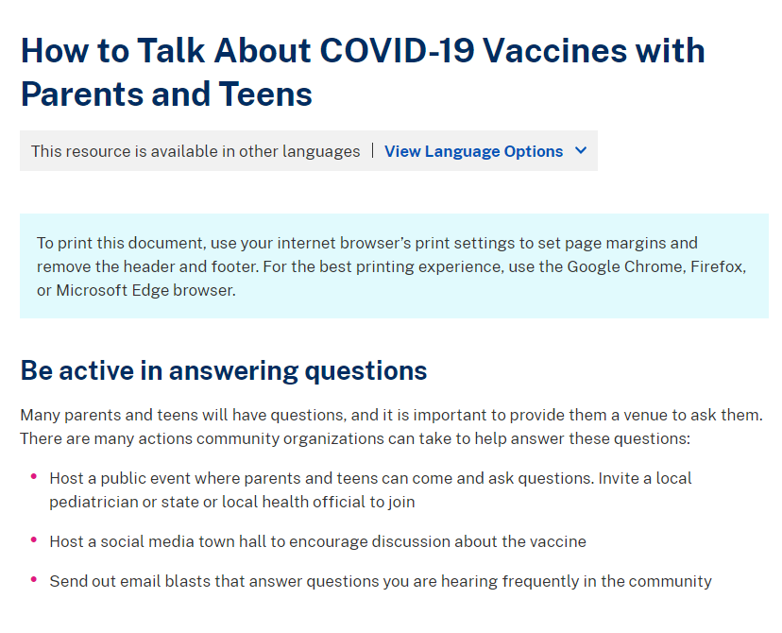
Additional Resources (Continued)
High School Students Toolkit — English/Spanish
How to Talk About COVID-19 Vaccines With Parents and Teens

Slide 19
Thank you, teachers, for serving as trusted messengers to increase vaccine confidence!

